Slide 1

Infosys Intern Program
RoadSafe Analytics: Road Accidents - Exploratory Data Analysis (EDA)
Presented By AI Intern Team

Slide 2



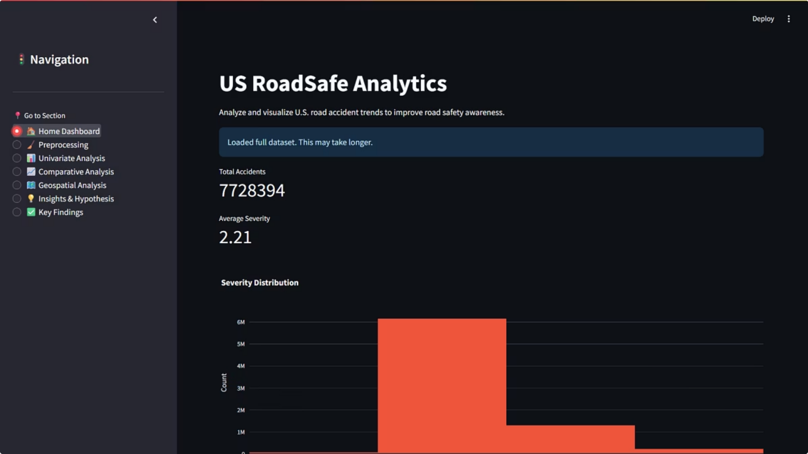

Project Goals and Scope
Analyze 7.7M Records
Uncover Trends & Patterns
Perform in-depth EDA on a large-scale dataset covering 49 US states from 2016 to 2023.
Identify temporal, spatial, and environmental factors contributing to accident occurrence and severity.
Generate Actionable Insights
Provide evidence-based findings for transportation authorities, urban planners, and policy makers.

Slide 3















The 15-Step Data Preprocessing Pipeline
Transforming a colossal 7.7 million raw records into a refined, analytically ready dataset was a critical first step. This was achieved through a meticulously designed 15-step data preprocessing pipeline, resulting in a robust dataset of 6.9 million rows with 35 crucial columns and, crucially, zero missing data points.
Data Acquisition
Column Selection
Duplicate Removal
Loaded 47 raw columns from the extensive US Accidents dataset.
Identified and selected the most relevant 35 columns for analysis.
Eliminated all exact duplicate records to ensure data uniqueness.
Data Type Conversion
Geographic Cleaning
Temporal Parsing
Ensured correct data types for all columns (e.g., datetime, numeric).
Standardized and validated latitude/longitude entries for accuracy.
Extracted and formatted date/time information from raw timestamps.
High-Missing Column Drop
Outlier Detection
Weather Imputation
Strategically removed columns with excessive missing data (e.g., End_Lat/Lng).
Identified and flagged potential outliers in key numerical features.
Filled missing weather data (Wind Speed, Precipitation) using median imputation.
Advanced Imputation
Feature Engineering: Time
Categorical Encoding
Applied linear regression for more complex imputation of specific missing values.
Derived 'Accident Duration', 'Hour of Day', and 'IsWeekend' features.
Transformed categorical variables into numerical representations for models.
Data Normalization
Final Validation
Dataset Export
Scaled numerical features to a standard range for consistent analysis.
Conducted a thorough check for data integrity and consistency across all 6.9M rows.
Exported the clean, validated dataset for downstream analysis and modeling.

Slide 4
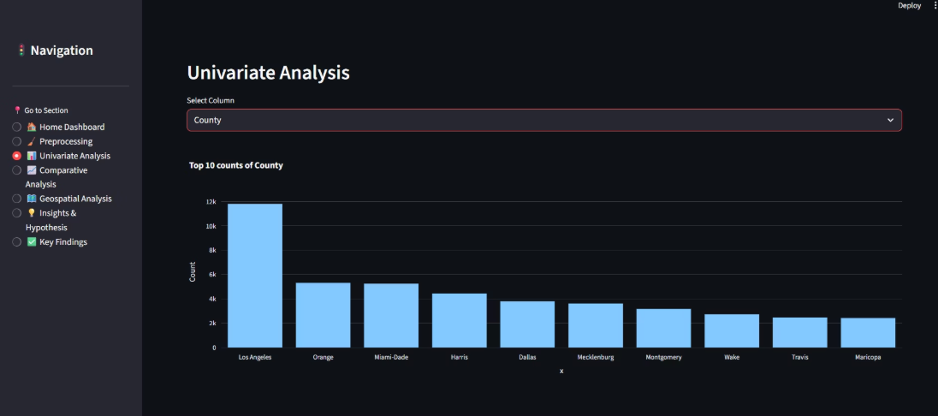
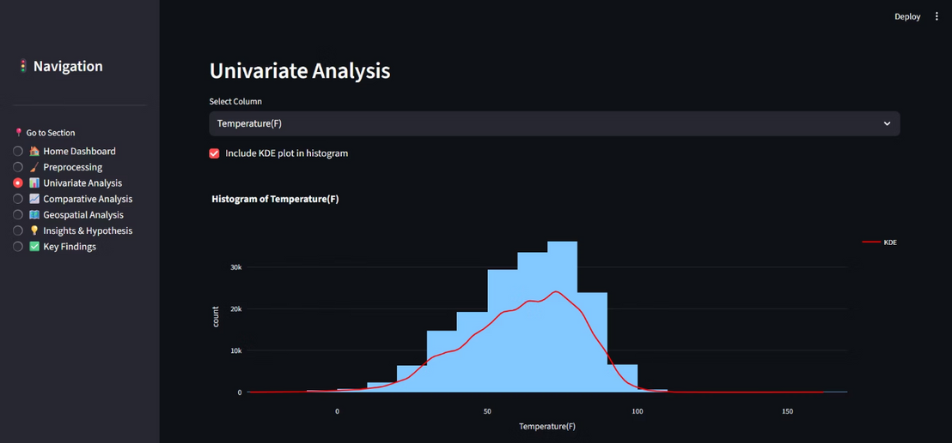
Univariate Analysis: Understanding Feature Distributions
The Univariate Analysis module allows users to explore the distribution of any selected column, automatically adapting the visualization based on data type. This initial exploration was crucial for understanding the inherent characteristics of each feature, identifying potential data quality issues, and informing subsequent preprocessing and modeling decisions.
Numerical Features
Categorical Features
Visualized using Histograms with an optional Kernel Density Estimate (KDE) overlay to show frequency and probability density. Key statistics like mean, median, standard deviation, skewness, and kurtosis were calculated to describe the central tendency, dispersion, and shape of each distribution.
Visualized using Bar Charts displaying the top 10 most frequent categories, sorted by count for quick identification of dominant values.Frequency counts and percentages were calculated, providing a clear overview of their prevalence.
Data Quality Insights & Patterns: Analysis of State revealed that California (CA) consistently had the highest number of reported accidents, significantly outpacing other states. The presence of numerous rare categories in features like City indicated a need for potential aggregation or targeted encoding strategies.
Data Quality Insights & Patterns: For numerical features such as Distance(mi) and Temperature(F), histograms revealed heavily right-skewed distributions, indicating a large number of short-distance accidents and temperatures clustering around common ranges.

Slide 5
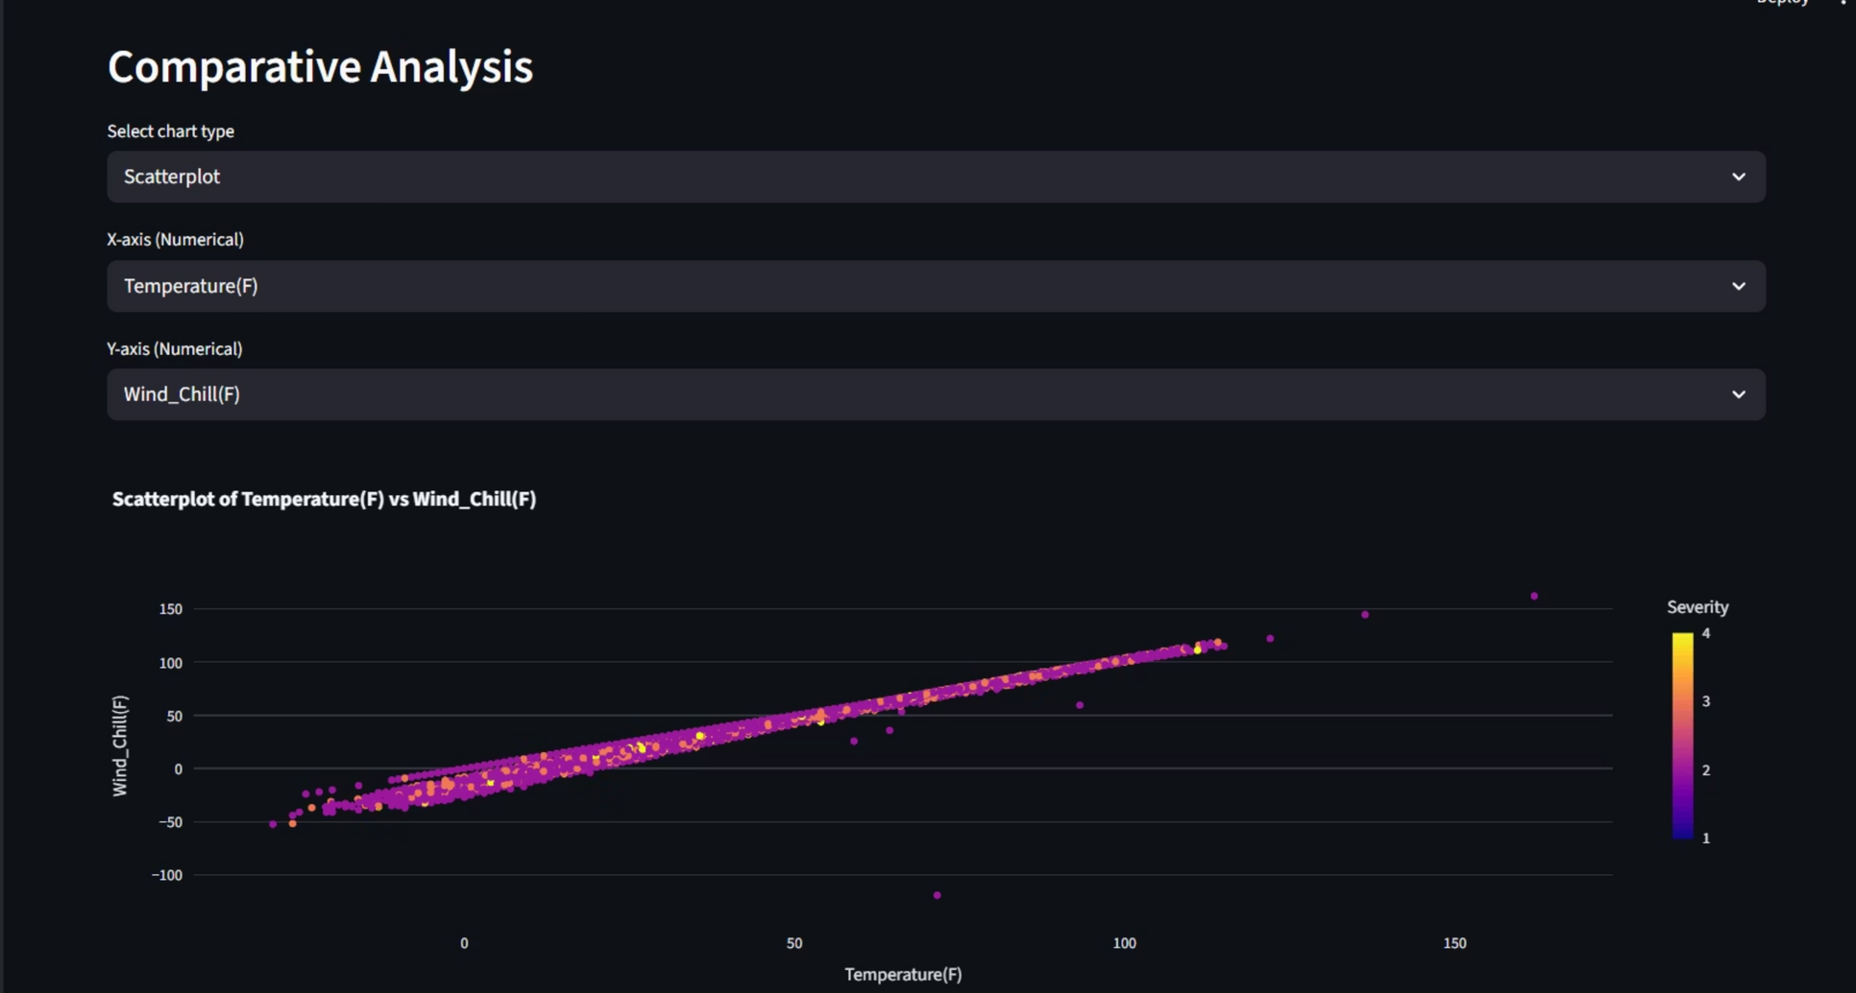
Comparative Analysis: Understanding Feature Distributions
The Comparative Analysis module enables users to examine multiple features concurrently, facilitating side-by-side comparisons and cross-tabulation analysis. This functionality is crucial for identifying intricate relationships and dependencies between various variables, such as accident severity across different weather conditions or states. By uncovering these correlations, we gain deeper insights into complex accident patterns, which is vital for developing targeted prevention strategies and improving predictive models.

Slide 6
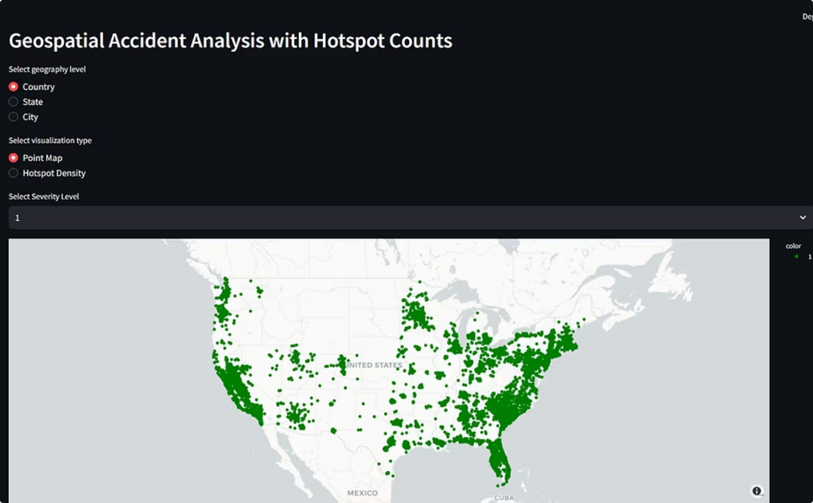
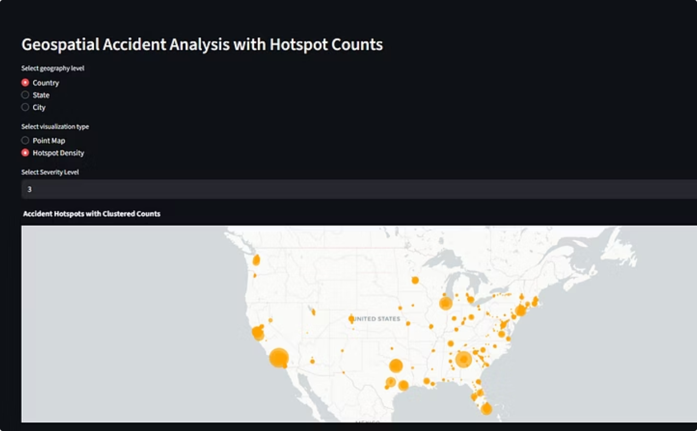
Geospatial Analysis: Identifying Accident Hotspots
The Geospatial module enables filtering accident data by Country, State, or City, utilizing both Point Maps and Hotspot Density Maps to visualize accident locations and patterns effectively. This approach allows for a deep dive into geographical accident trends, crucial for targeted safety interventions.
The methodology involves processing millions of geocoded accident records. Each record includes precise latitude and longitude coordinates, allowing for accurate placement on a map. This granular location data is essential for identifying specific areas with higher accident frequencies, moving beyond simple aggregated statistics to spatial insights.
Point Map
Hotspot Density Map
The Point Map visualizes individual accident locations as distinct markers, with each marker colored according to accident severity (ranging from Green for Severity 1 to Red for Severity 4). This immediate visual cue helps users quickly gauge the impact of accidents in different areas.
The Hotspot Density Map employs the DBSCAN (Density-Based Spatial Clustering of Applications with Noise) algorithm to identify high-risk zones. DBSCAN groups together data points that are closely packed together, marking as outliers those points that lie alone in low-density regions.
Identifying Risk Patterns and Practical Applications
By leveraging both point and density maps alongside interactive filtering, the module provides a powerful tool for identifying underlying risk patterns. Analyzing the attributes of accidents within these hotspots (e.g., time of day, weather conditions, contributing factors) can reveal specific vulnerabilities.
Urban planners can use hotspot data to inform decisions on road infrastructure improvements, installation of traffic calming measures, or redesign of dangerous intersections. Traffic management agencies can optimize resource allocation, such as deploying police patrols to high-risk areas or adjusting traffic light timings to mitigate congestion. Furthermore, these insights can support policy development, guiding decisions on speed limits, driver education campaigns, and overall road safety strategies to create safer communities.

Slide 7
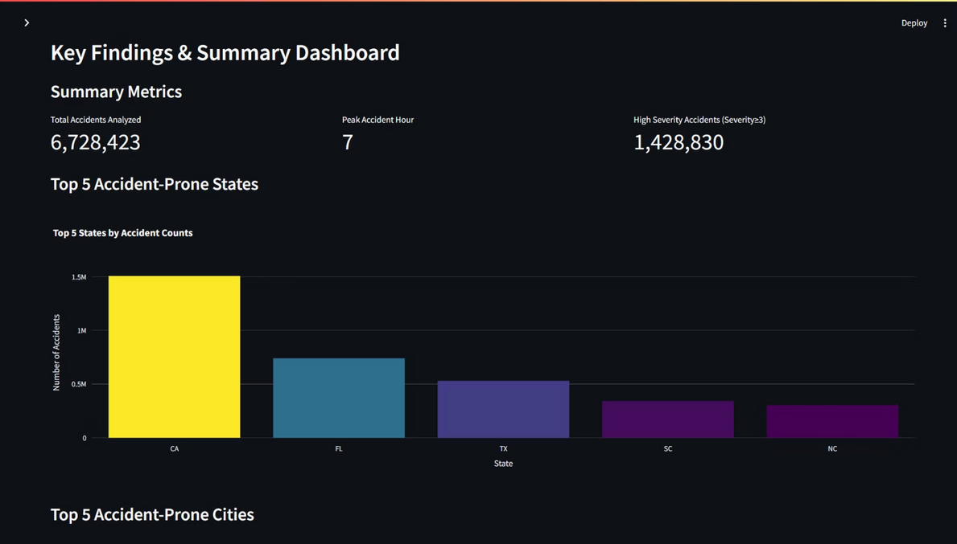
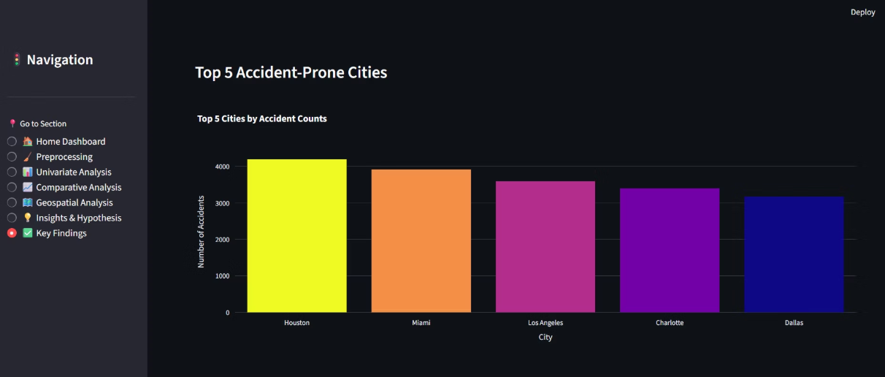
Spatial Findings: Top Accident-Prone Regions
Analysis of 6.7 million accidents revealed significant geographic concentration in specific states and major metropolitan areas.
Top 5 Accident States
Top 5 Accident Cities
California (CA): 1.5 million accidents
Houston
Florida (FL)
Miami
Texas (TX)
Los Angeles
South Carolina (SC)
Charlotte
North Carolina (NC)
Dallas

Slide 8

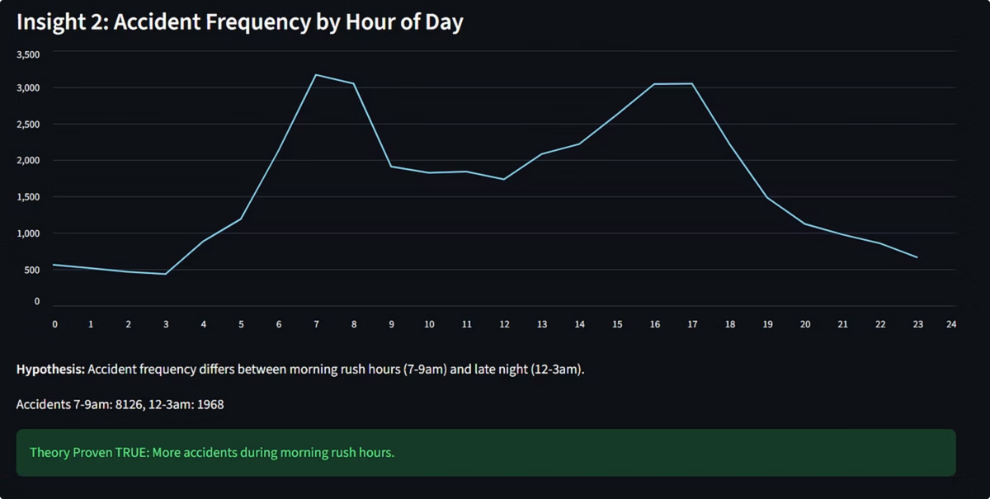
Hypothesis: Accident Frequency by Hour of Day
Accidents are significantly higher during morning rush hours (7-9am: 8126) compared to late night (12-3am: 1968), proving the hypothesis true.

Slide 9
Key Insights from Statistical Validation
Eight hypotheses were tested to validate contributing factors to accident frequency and severity. Most theories were supported by the data.
59%
p<0.001
Morning Rush
Rain Impact
More accidents occur during morning rush (7–9 am) vs. late night (12–3 am).
Rain significantly affects accident severity/frequency.
9/12
p=0.1493
Road Features
Weather Severity
Features like Junction, Crossing, and Traffic Signal significantly impact severity.
No significant difference in mean severity between "Clear" and "Rain" conditions.
Only two hypotheses (Weather Conditions on Severity and Humidity Correlation) were proven false, indicating complexity in environmental factors.

Slide 10
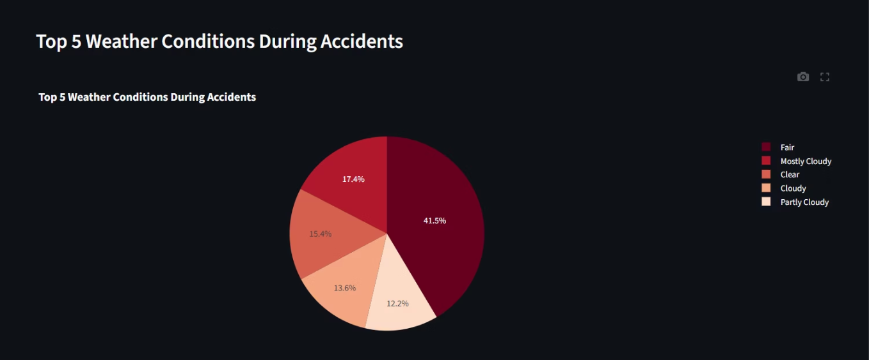
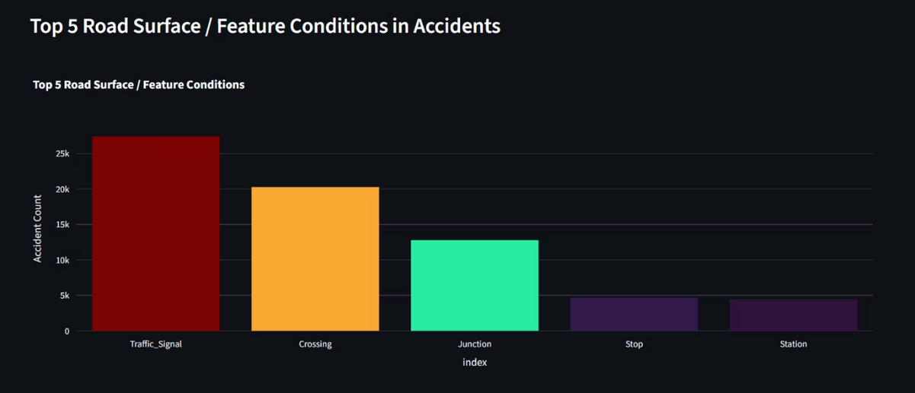
Top Environmental and Infrastructure Factors
Top 5 Weather Conditions
Clear
Rain
Cloudy/Partly Cloudy
Light Drizzle
Light Rain
Weather-related risk factors are prominent, even in seemingly "clear" conditions.
Top 5 Road Features
Traffic Signal
Crossing
Junction
Stop
Station
Complex road infrastructures and intersections are consistently identified as high-risk zones.

Slide 11



Technical Stack and Dashboard Architecture
The RoadSafe Analytics project is built on a robust Python-based data science stack, deployed via a modular Streamlit dashboard.
Streamlit
Python 3.x
Interactive web dashboard for real-time metrics and visualization.
Core language for data manipulation and statistical analysis.
Pandas/NumPy
Plotly/SciPy
Efficient data manipulation and numerical computing.
Interactive visualizations and statistical testing.
The dashboard provides a transparent, error-resilient, and reproducible environment for stakeholders to access cleaned data and key findings.

Slide 12
Conclusion & Impact
The RoadSafe Analytics project successfully analyzed over 7.7 million accident records, leading to several key achievements. We validated hypotheses regarding peak accident hours and the significant impact of weather conditions. Furthermore, our analysis pinpointed high-risk geographical areas and specific road features contributing to accidents. To make these insights actionable, we developed an interactive Streamlit dashboard.
This project provides invaluable data to inform evidence-based road safety policies and infrastructure investments. The findings offer a strong foundation for future applications aimed at proactive accident prevention and enhancing overall road safety.

Slide 13
THANK YOU

